Slide 1
Jenkins
Hands-on labs

Slide 2

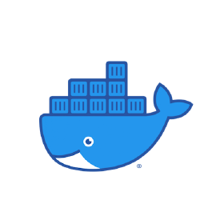

Prerequisites:
GitHub account
Docker instalation
AWS account

Slide 3
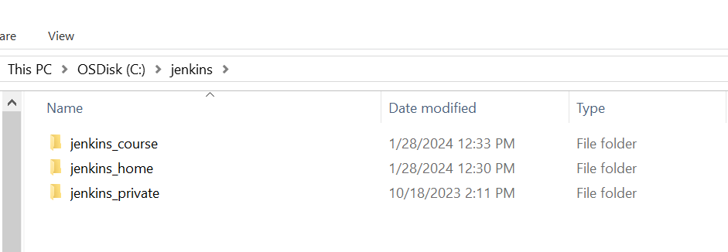
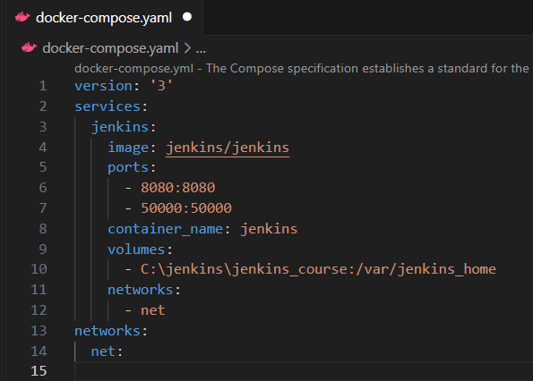
Preparing the environment:
Create a folder to save Jenkins
configuration (in my case I will name it
jenkins_course)
In other folder, create the next file:
docker-compose.yaml

Slide 4
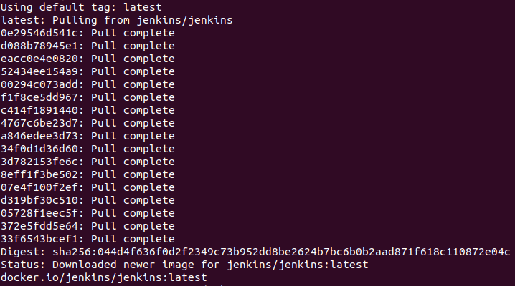
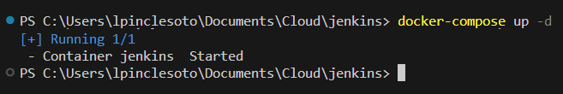
Loading Jenkins server
Open a terminal and go to the
path where you have your
docker-compose.yaml file.
2. Execute the next
command:
docker pull jenkins/jenkins
3. After that, execute the next
command:
docker compose up –d

Slide 5
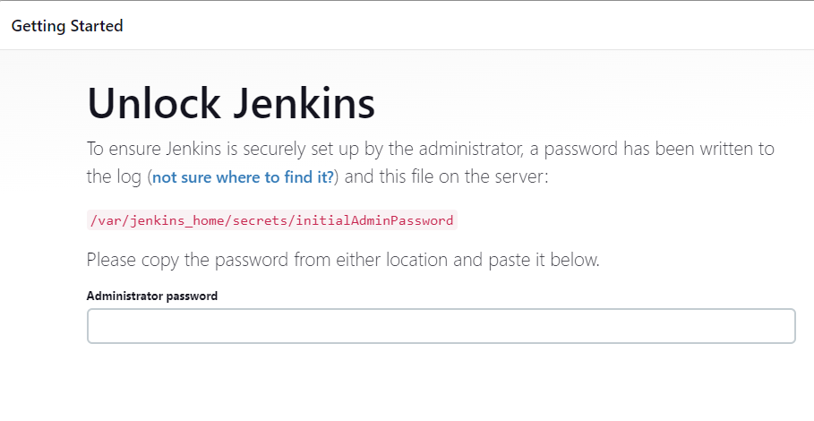
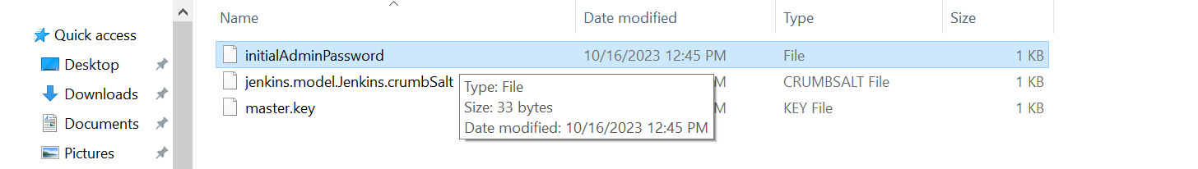
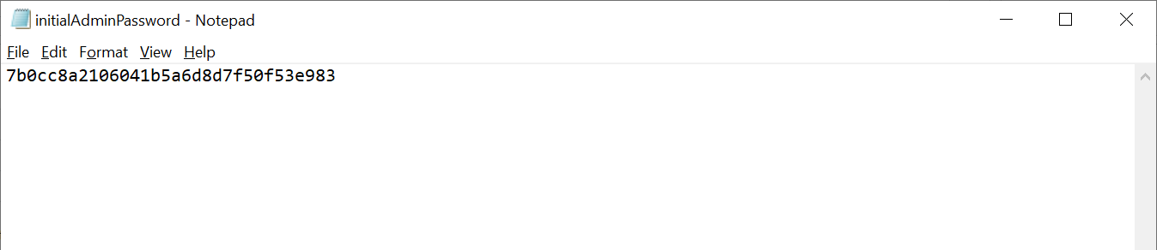
Jenkins server – first steps
Open your browser and write the
following: http://localhost:8080
2. You must open the file
“initialAdminPassword”
its location is:
“C:\jenkins\jenkins_course\secrets”
3. Copy the text and paste it
in the “Administrator password”
Textbox.

Slide 6
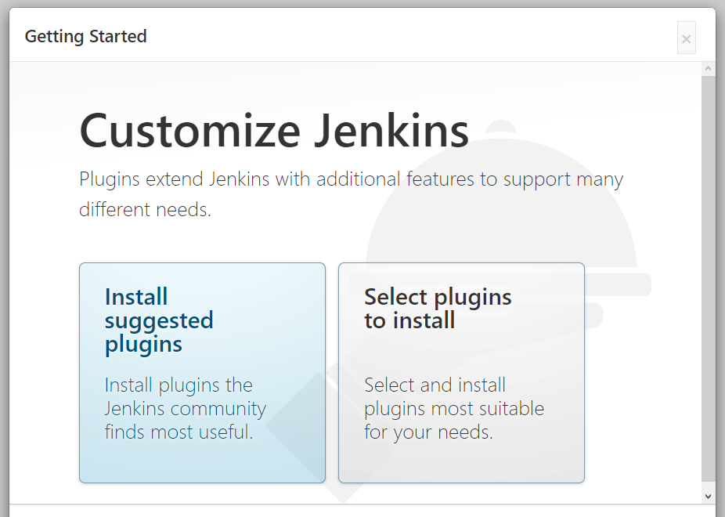
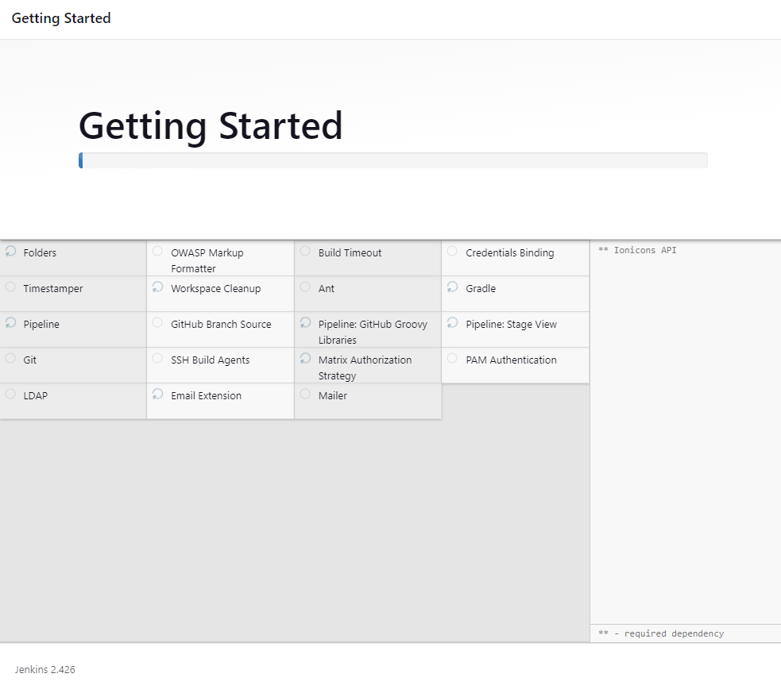
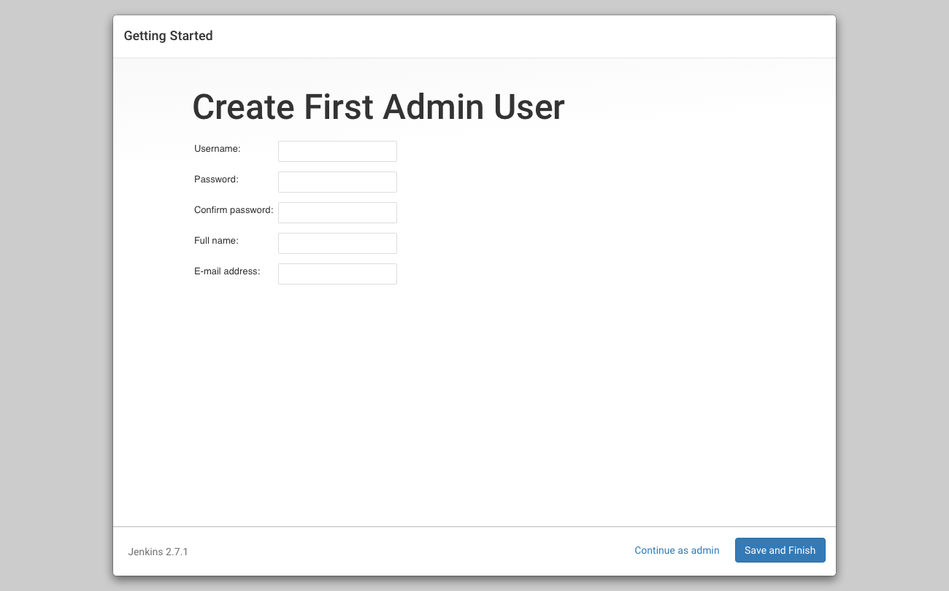
Click on “Install suggested
plugins”.
5. You must define the following
information (in my case I defined
the Username as admin) and click
on “Save and Finish”

Slide 7
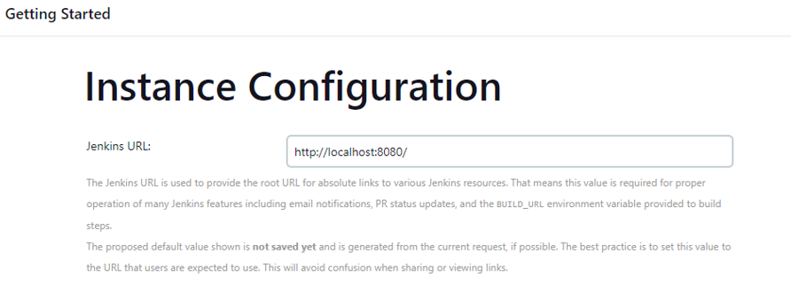
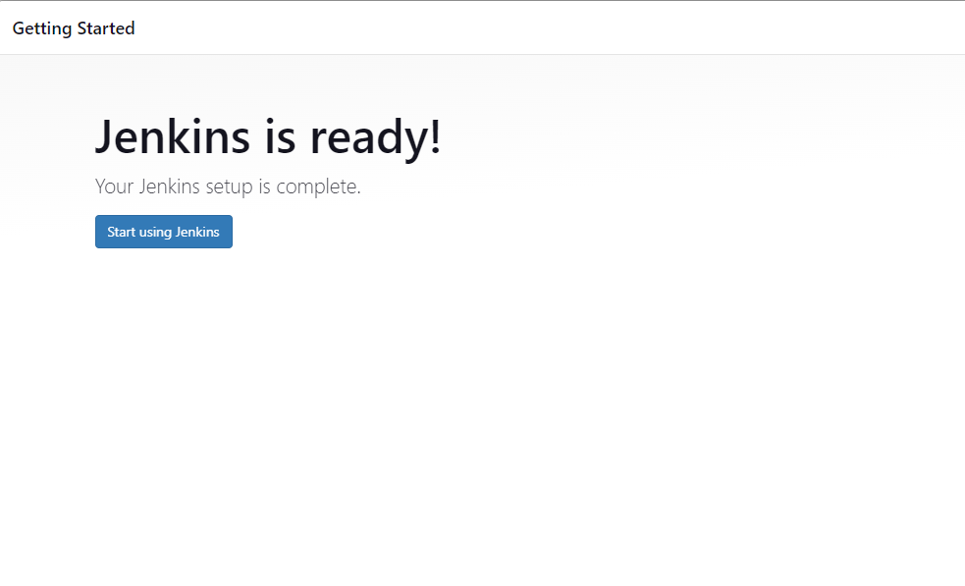
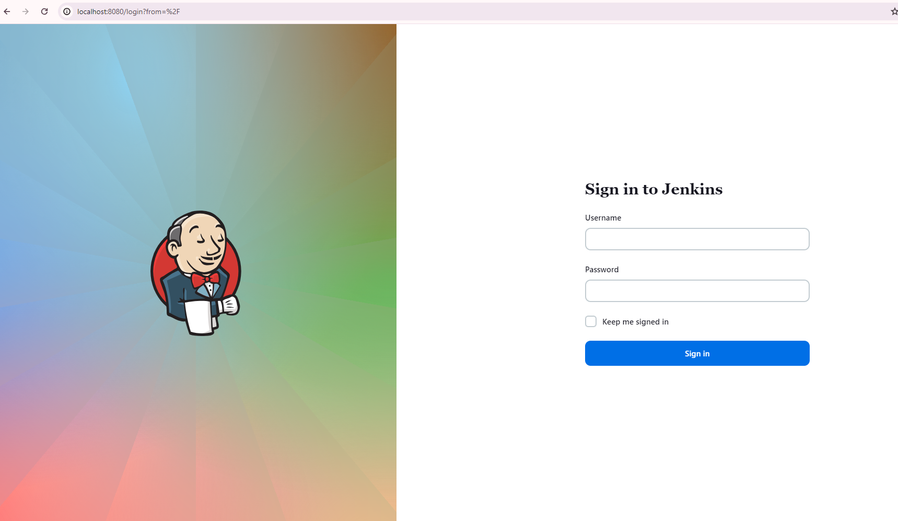
6. Click “Save and Finish”

Slide 8
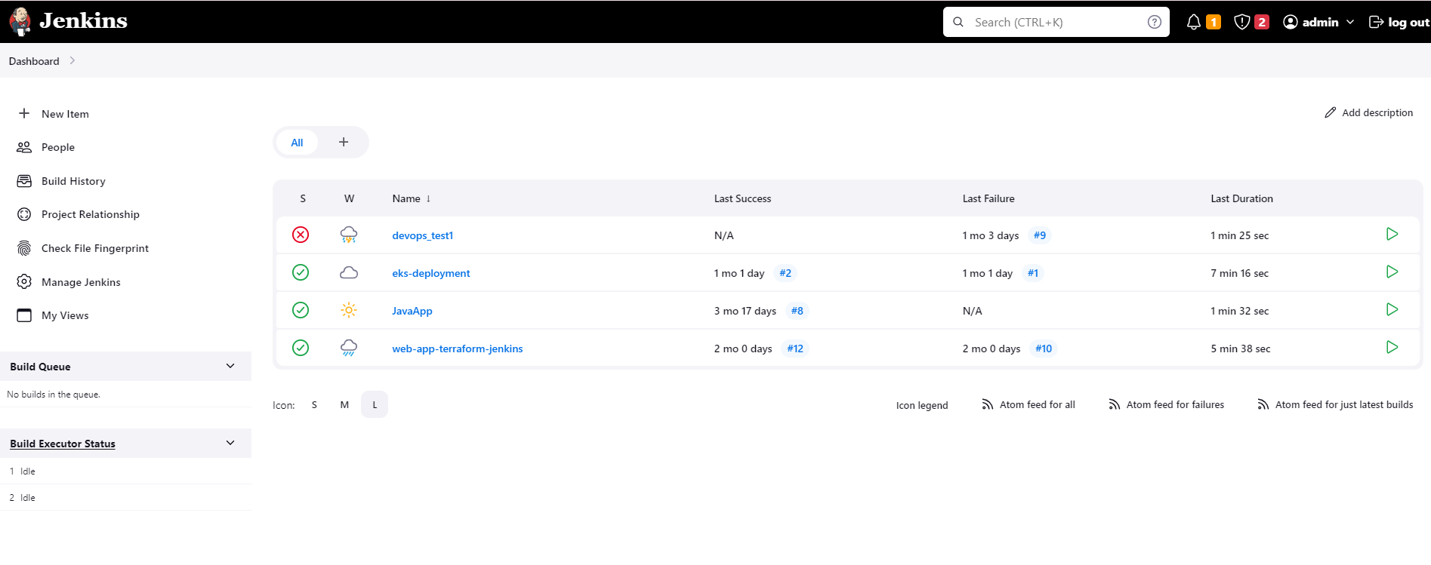
Jenkins dashboard

Slide 9
Side bar – general components

Slide 10
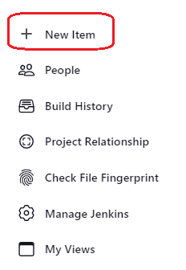
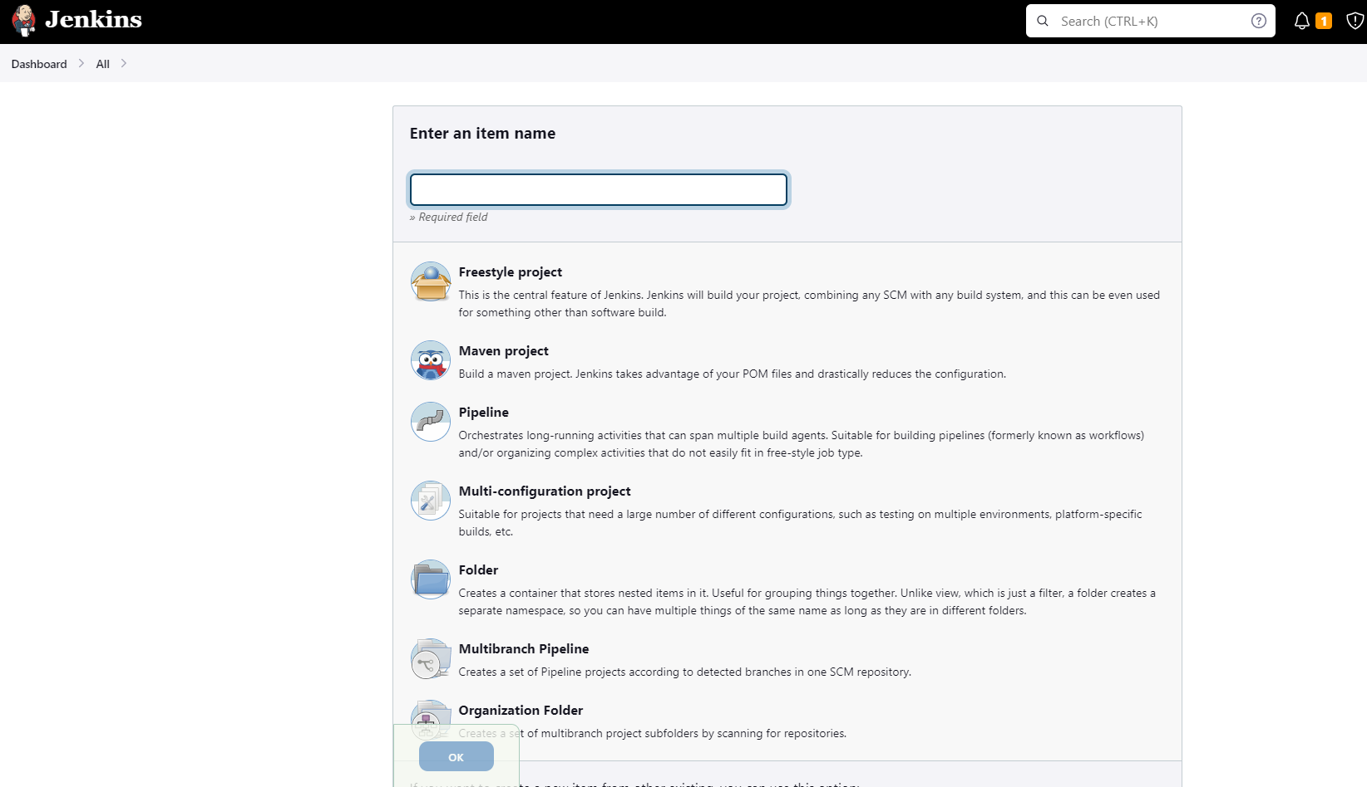
This option allows us to see all
the different items, we are going
to work with “Freestyle Project”
and “Pipeline”.

Slide 11
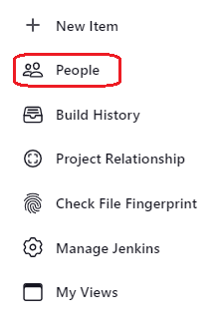
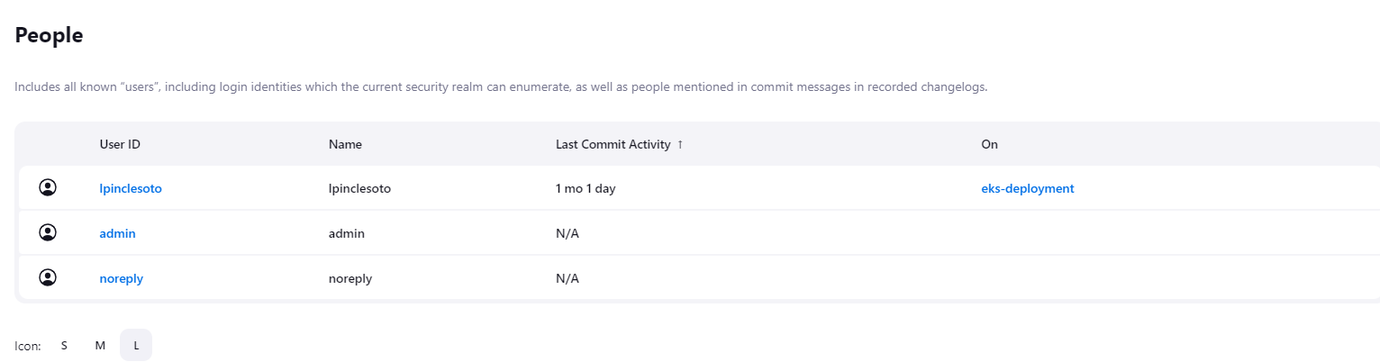
Here, we can find a list of the
existing users.

Slide 12
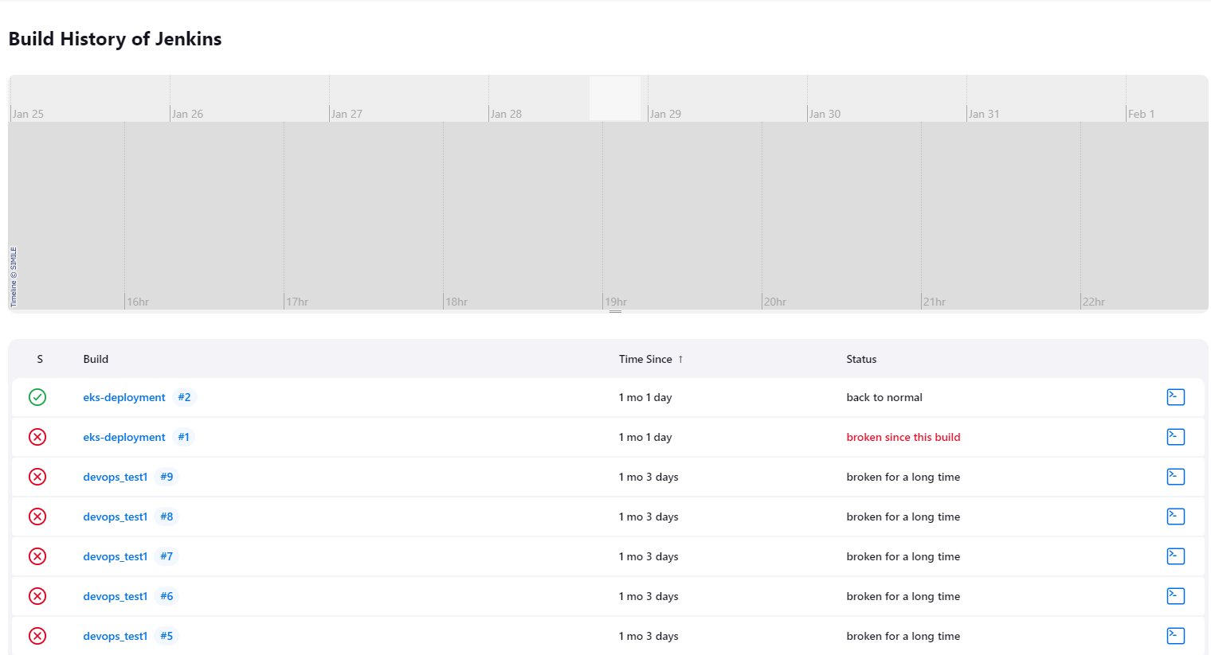
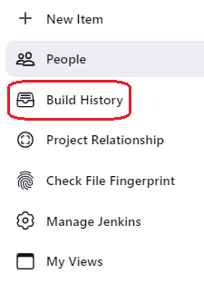
In this section, we have the list of
our job executions.

Slide 13
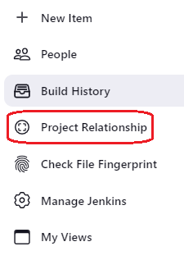
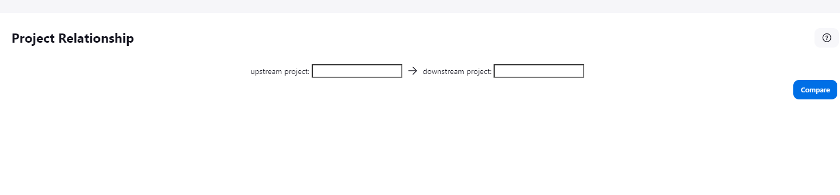
We can compare the relationship
beetwen Projects in this option.

Slide 14
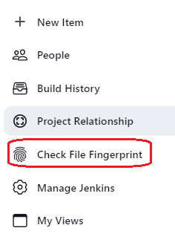
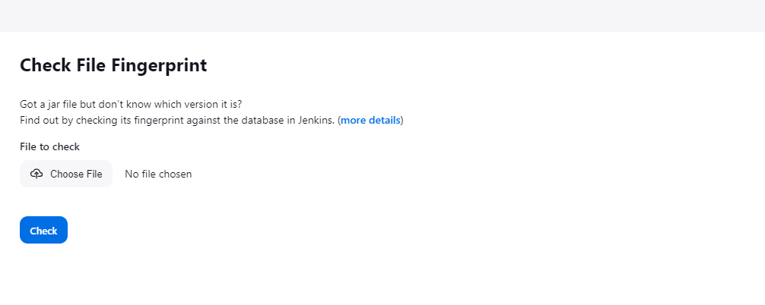
As you can see, this option help us
To know the jar file correct version.

Slide 15
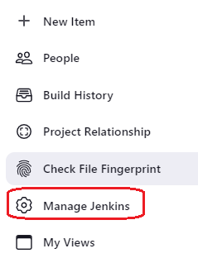
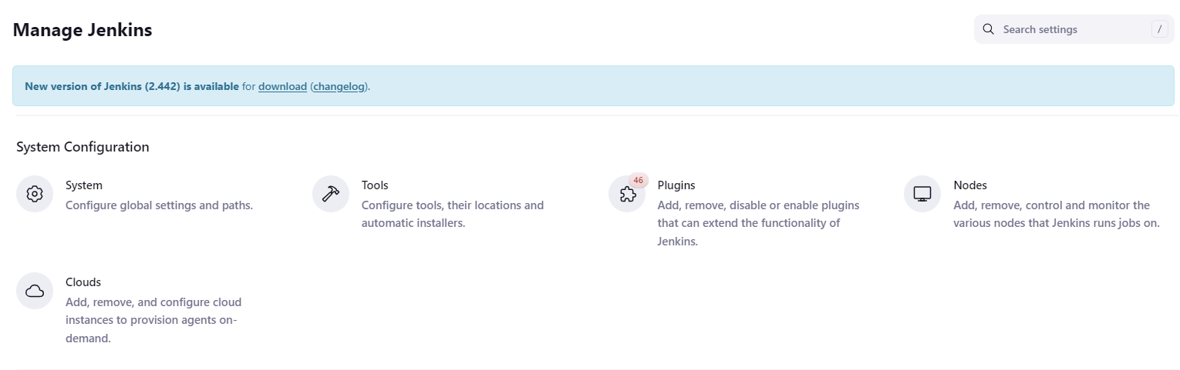
I think one of the most important
sections, here we can find all the
Jenkins configurations.

Slide 16
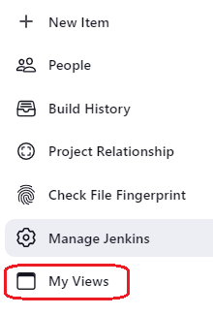
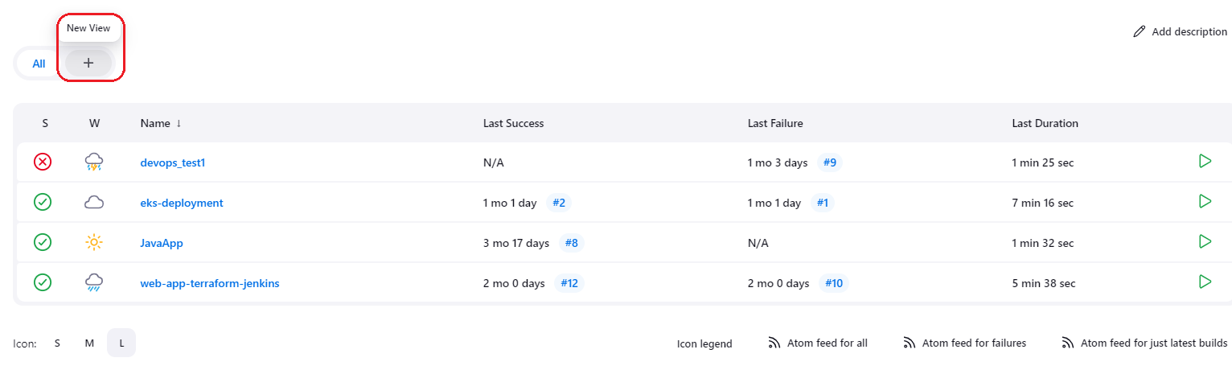
Here, we can configure our
personalized views.

Slide 17
Building our first job

Slide 18
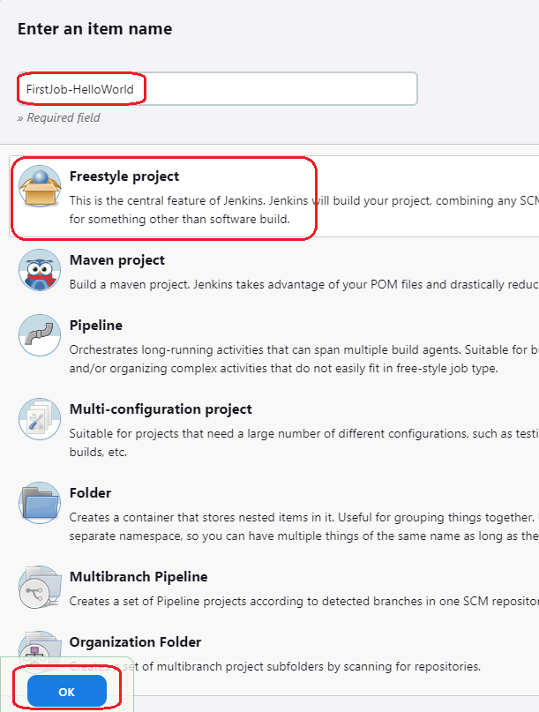
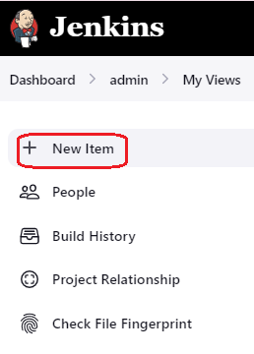
Open the next Github repository:
https://github.com/LeoPincle/jenkins_hands-on.git
2. In the Jenkins dashboard, select “New Item”.
Assign a name.
Select “Freestyle Project.
Click on “Ok”.

Slide 19
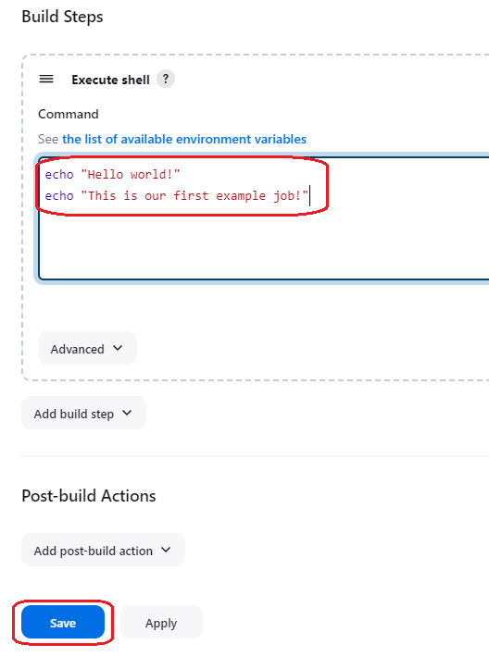
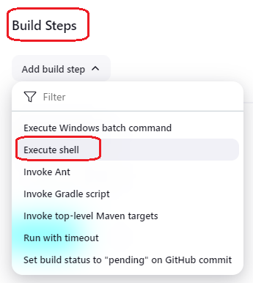
Go to “Build Steps” section.
Click on “Add build step” and select
“Execute Shell”.
8. In the repository, open the 01-First-Job.md file,
copy and paste the content in the textarea
“Command”, and save the changes.

Slide 20
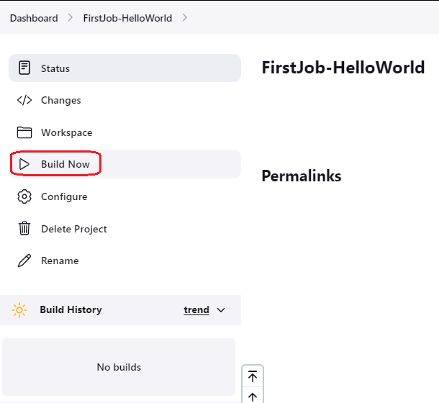
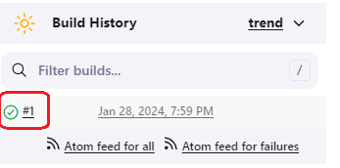
Now we can see our Job menu options.
Click on “Build now”
After that, we will see the result in the “Build History” section.
Click on “#1”

Slide 21
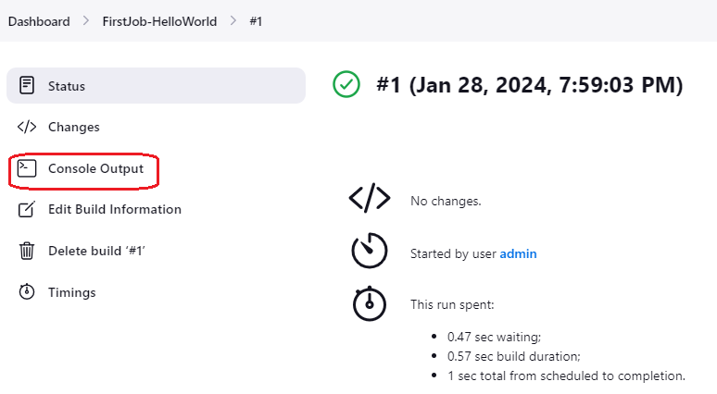
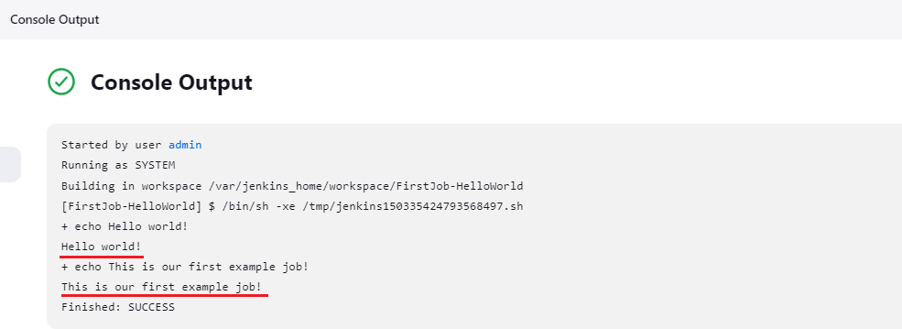
Click on “Console Output”
Here we can see the result of the execution.

Slide 22
Using Shell scripts

Slide 23
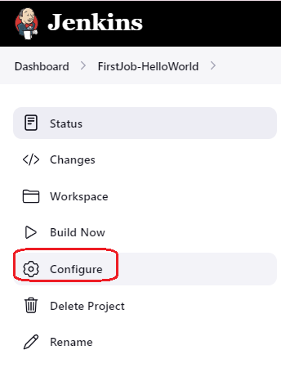
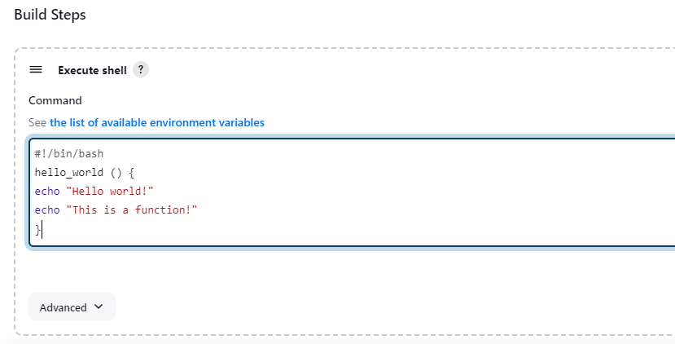
1. Open the job configuration.
2. Copy the 02-First-Job-Script.md content and paste it in the “Command” section, and sabe the changes.

Slide 24
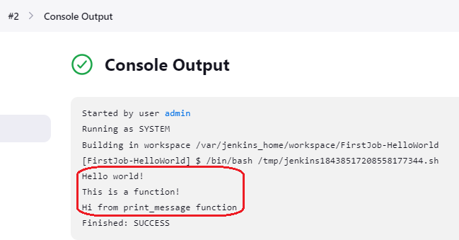
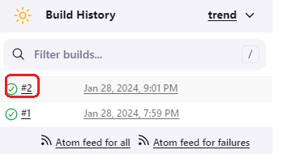
Click on “Build now”, after that we will see a new row in the “Build History” section
Click on “#2” and go to the “Console output” option
As you can see, we have the result of the functions execution.

Slide 25
Using Shell file script

Slide 26
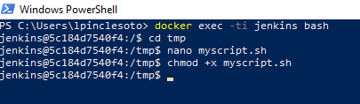
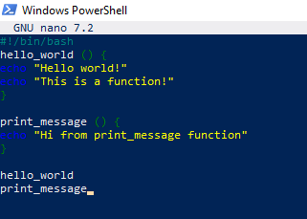
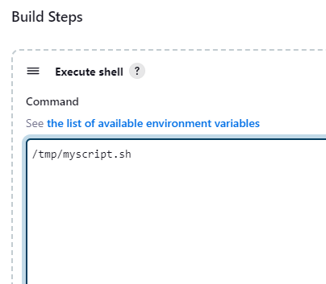
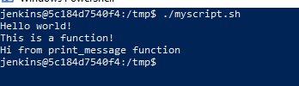
Go to the file 03-First-Job-file.md, we have here the commands we will
use.
Open a terminal, execute the command: docker exec –ti jenkins bash
This command Will help us to get into our Jenkins server.
Go to /tmp path ( cd /tmp), we are going to create the myscript.sh file,
write nano myscript.sh and press enter.
4. Copy and paste the 02-First-Job-Script.md content, press “Ctrl+x” and
confirm the changes.
We have to give execution persmission to the file with the command:
chmod +x myscript.sh
6. We can validate the script execution: ./myscript.sh
7. In our job configuration we have to change the command by:
/tmp/myscript.sh
8. Save the changes

Slide 27
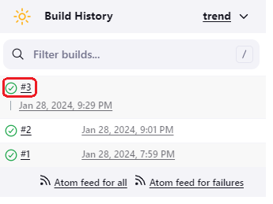
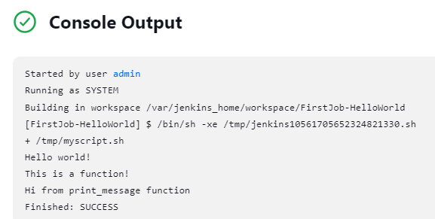
8. Click on “Build now”
9. We can validate the execution in the “Console output”

Slide 28
Using Shell file script
with variables

Slide 29
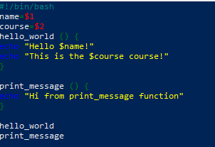
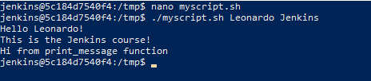
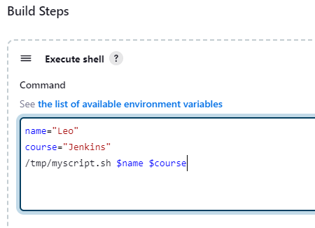

If is necessary, we can use variables in our
Scripts, we have here the example.

Slide 30
Second job
Web application with terraform infraestructure.

Slide 31



We are going to configure a new Jenkins job, this job will help us to create a fake website, its infrastructure
will be created on AWS through terraform code. We are going to work with a private repository.
Clone the next repository: https://github.com/LeoPincle/terraform-jenkins-CI-Public/tree/master
Change its visibility configuration to private

Slide 32


We need to create some AWS services, we will start with our S3 backend bucket
Open your AWS console
Look for S3 service+
Click on “Create bucket”, assign it a name, select a region, and create the bucket.

Slide 33


Look for “DynamoDB” service, click on “Create table”
Assign a name and in the “Partition key” option, you must write “LockID”, after that click on “Create table.”

Slide 34


IMPORTANT NOTE: You must replace the S3 bucket name and the DynamoDB table in the “ts-backend.tf” file:
bucket = your bucket name
dynamodb_table = your dynamodb table name

Slide 35



8. Look for “IAM” service, click on “Users”, and select “Create user”:

Slide 36


9. Select “Attach policies directly”, and for this lab we will select “AdministratorAccess” policy, click next and
you will see the review, click on the “Create” button.

Slide 37



10. Go to “Security credentials” tab, click on “Create access key”, In “Use case” select “Command Line
Interface (CLI)”, check the confirmation, and click on “Next”

Slide 38


11. You can define a tag, this step is optional, click on “Create access key”, you will see the “Access key” and
the “Secret access key”, click on “Download .csv file”, and click on “Done”.

Slide 39

We need to generate the SSH keys, these keys will help us with the access to the private repository.
12. In your favorite browser, open the next link:
https://docs.github.com/en/authentication/connecting-to-github-with-ssh/generating-a-
new-ssh-key-and-adding-it-to-the-ssh-agent

Slide 40


13. To summarize, you must execute the next command on a PowerShell terminal:
ssh-keygen -t ed25519 -C "your_email@example.com"
14. Verify that you have the next files (you can copy them to another path)

Slide 41



14. Execute the next command (cat id_ed25519) and copy all the result mark with the red line:
15. In you GitHub account, go to “Settings”, select “SSH and GPG keys”, click on “New SSH key”

Slide 42


16. Paste the SSH generated, assign it a name, and click on “Add SSH Key”.
We have generated the SSH keys, until here we have created the authentication key on Github, later we will
use the private file (id_ed25519), keep it on mind.

Slide 43


17. Now, we are going to configure our AWS credentials on Jenkins, in the dashboard select “Manage Jenkins”,
Click on “Credentials”

Slide 44


17. Click on “global”, select “Add Credentials”

Slide 45


18. Select “Secret text” option:
19. Open the file that contains your “Access key ID” and “Secret access key”:

Slide 46



20. Copy and paste your “Access key Id”, define a name, and click on “Create”.
21. Copy and paste your “Secret access key”, define a name, and click on “Create”.
We will see the next result:

Slide 47


22. We need to go to our Jenkins Dashboard, click on “New Item”
23. Assign a name, select “Pipeline”, and click on”Ok”

Slide 48


24. Look for “Pipeline”, select “Pipeline script”:
25. Go to your repository, copy the Jenkins’ file content, and paste it in the “Script” section:

Slide 49


26. Click on “Pipeline Syntax”

Slide 50


27. In “Sample Step”, select “git: Git”:
28. Go to your repository, copy the SSH option:

Slide 51


29. Go back to Jenkins, and in the “Repository URL” paste the text (you will have an error message,
do not worry about it, we will solve it):
30. Click on “Add” and click on “Jenkins”:

Slide 52


31. In the “Kind” option, you must select “SSH Username with private key”:
32. You must define an ID, Description and in the “UserName” textbox, you must write your GitHub user,
in my case is LeoPincle:

Slide 53


33. Do you remember our private key? We will use it in the next step, go to the private key path in a PowerShell
terminal and execute the next command: cat id_ed25519
34. You must copy the complete text, including all the dashes. Go back to Jenkins, look for “Private Key” and click
on “Enter directly” option you must paste the private key text, save the changes clicking on “Add”:

Slide 54


35. In “Credentials”, select the created ssh connection:
36. Click on “Generate Pipeline Script”, and copy the result:

Slide 55


36. Paste the text you copied in the previous step in your pipeline script, specifically in the “Checkout” stage and
save the changes.

Slide 56


37. Click on “Build with Parameters”:
38. Select “autoApprove”, in the actions select “apply” and click on “Build”:
Apply: this option will create all the environment
Destroy: this option will delete all the environment

